Slide 1
Bruiser Bros
Creators: Chase balmos, Isaiah Brown, Karissa cleaver, Adriana Marin, Paul yu

Slide 2
Plan
Plot sprites
Move sprites
Collisions
Create Levels
Program other characters
Program score

Slide 3
Issues
Sprites would not plot
Jump to infinity
Collision bounce

Slide 4
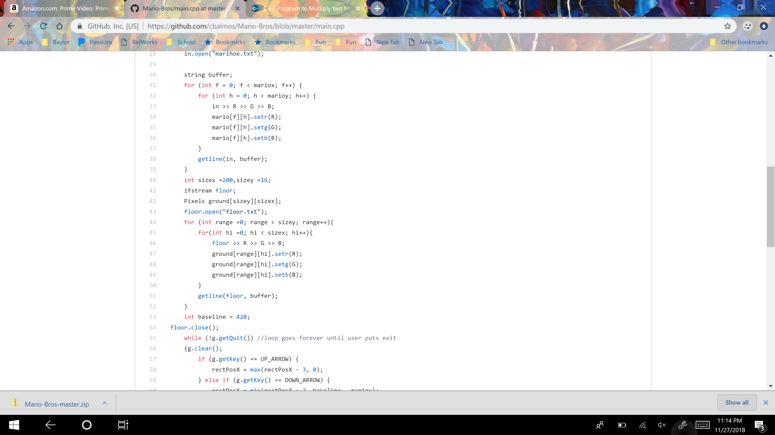
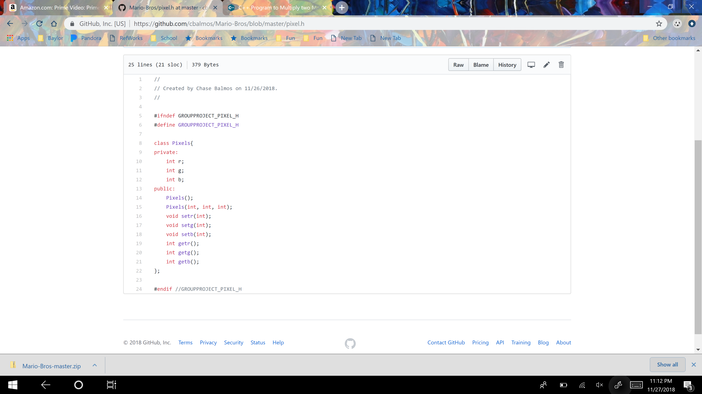
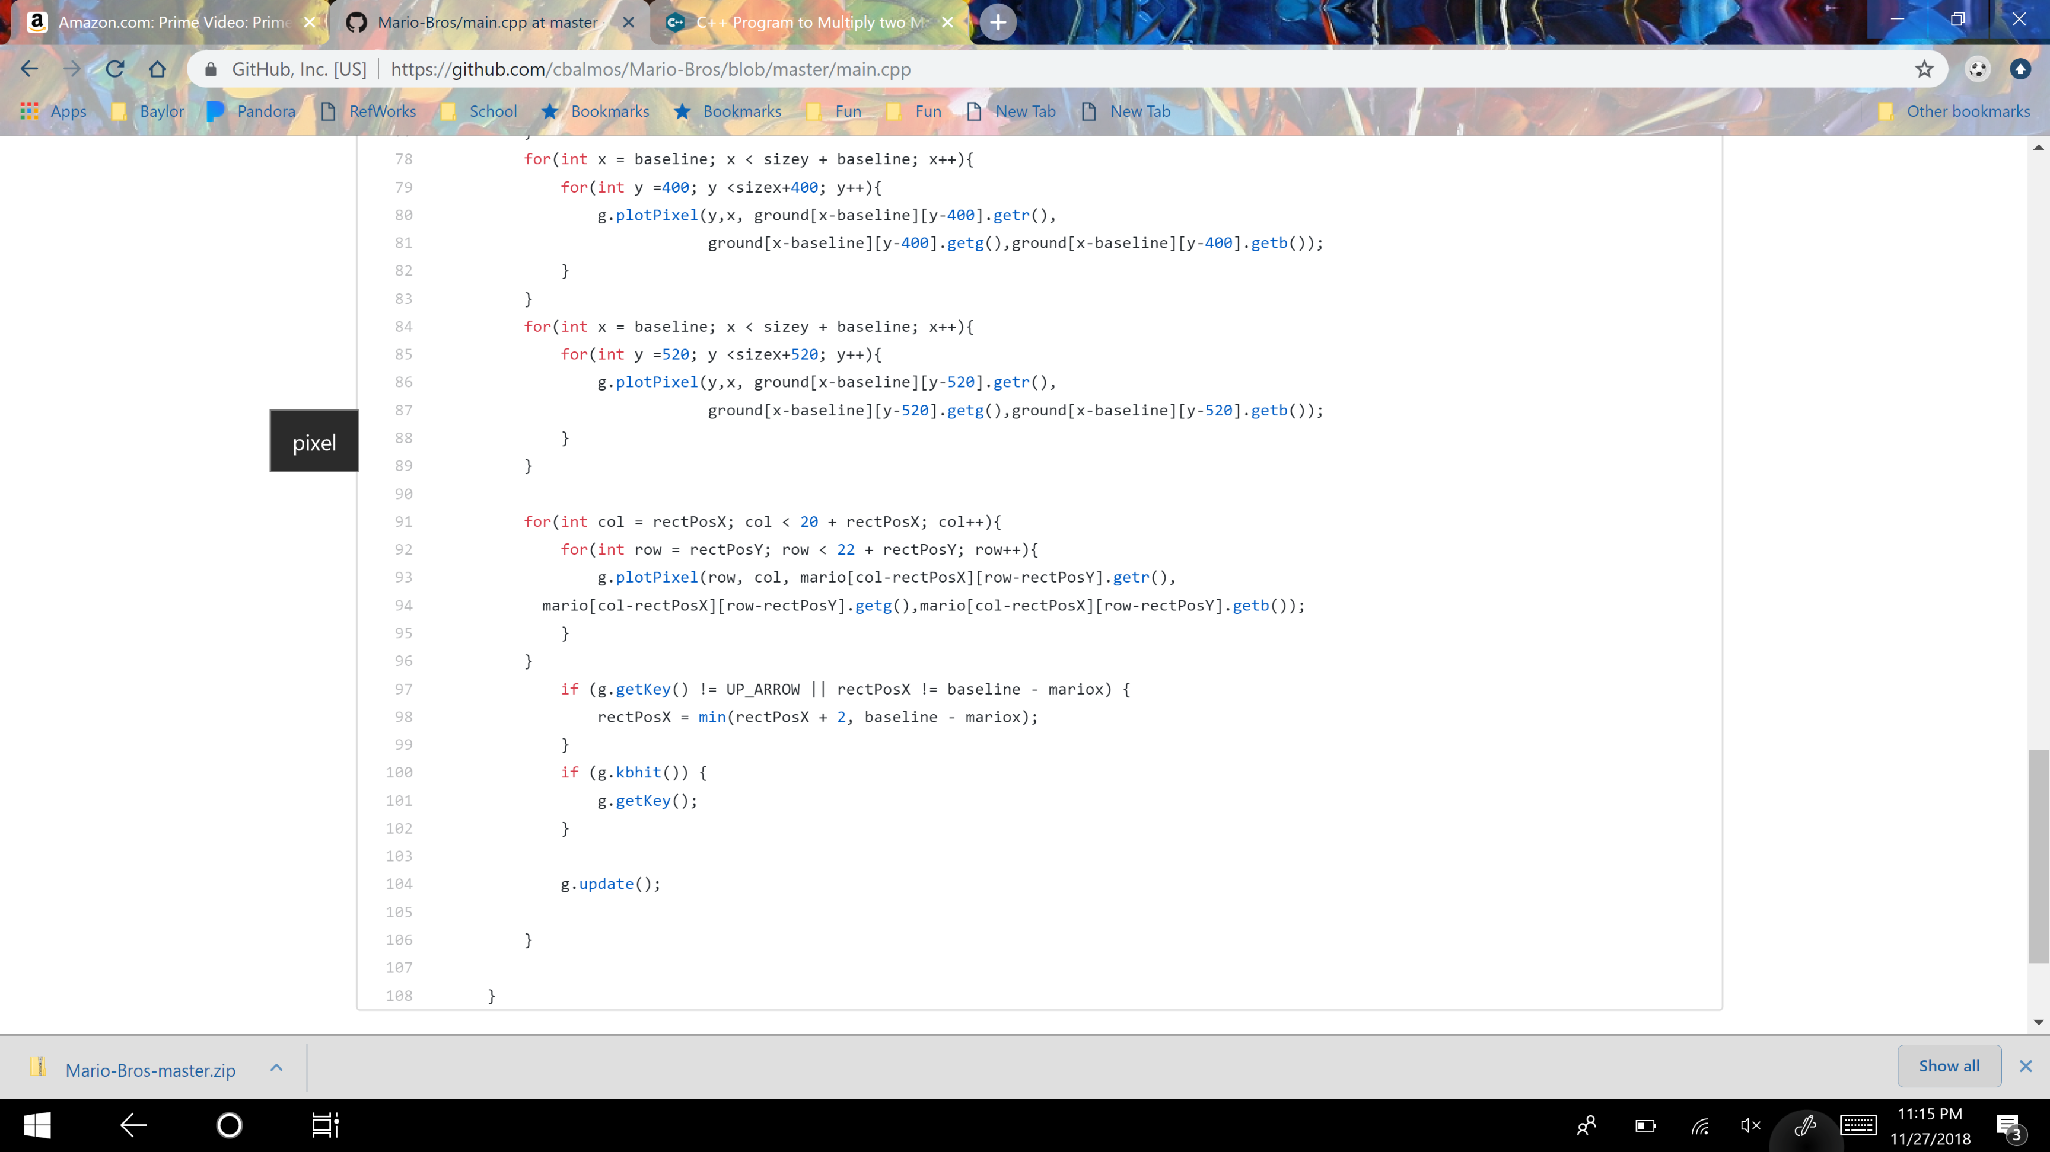
Solutions - Pixel

Slide 5
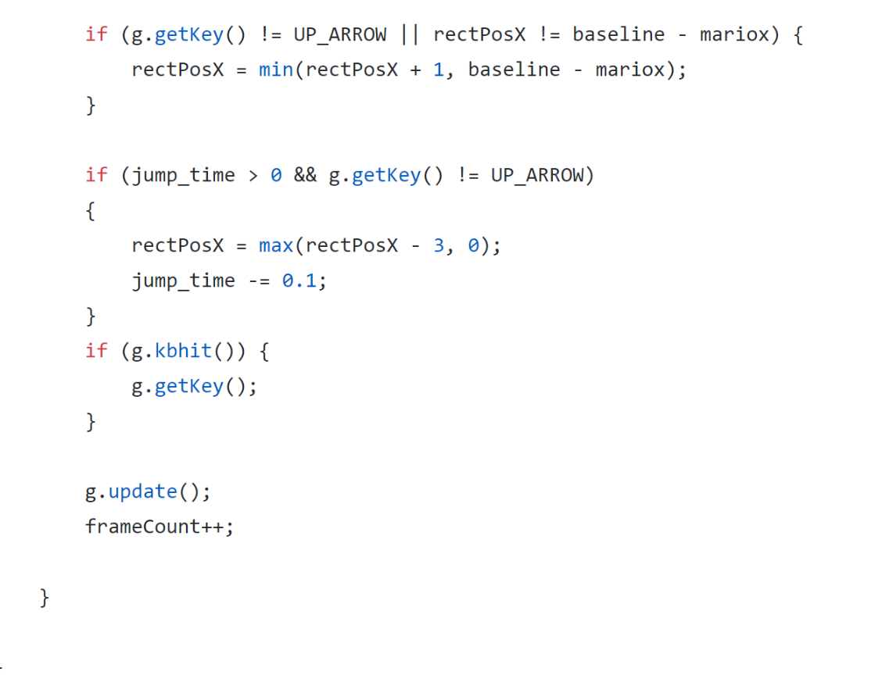
Solution – Jump

Slide 6
Solution - Collision
Distance between boundaries was too big
Solution was to make difference smaller

Slide 7
Demo

Slide 8
Code walkthrough

Slide 9
Roles
Isaiah = Character movement animation
Chase = Character movement animation
Karissa = Character Development
Adriana = Character Development
Paul = Collisions

